Slide 1
ESP32
Modules
Complementary
Filter
Balance
Controller
WIFI
Communication
output
Controller
& Webserver
Stepper
Motor
Web
Server

Slide 2
ESP32
FreeRTOS
Tasks
uartToDistance
Core 1
Task Scheduluer
keepMQTTAlive
Core 2
publishDeadreckoningData

Slide 3
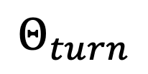
$$Θ_{turn}$$
Rover equipped with compass

